Slide 1
PH.D. RESEARCH PRESENTATION
Sentiment Analysis on
Gujarati Twitter Data
Comparing Classical Machine Learning, Transformer, and Cross-Lingual Approaches
Manish Joshi
Faculty of IT and Computer Science, Parul University
Supervisor: Dr. Snehlata Barde

Slide 2


Executive Summary
The Data Gap
The Methodology
The Result
No usable public Gujarati text corpus exists.
Frozen multilingual encoders versus classical baselines.
IndicBERT v2 dominates translated product reviews.

Slide 3
THE TARGET AUDIENCE
55 Million
First-language Gujarati speakers globally.
Yet sentiment-analysis tooling heavily lags English and Hindi.

Slide 4

The GSAC Corpus Problem
Distributed as IDs: Only tweet identifiers available.
API Closed: Rehydration is now impossible.
Data Decay: Old social media deletes over time.
Zero Open Text Datasets
Conclusion: The only open dataset is effectively unusable.

Slide 5
The "Fine-Tuning" Assumption
STANDARD PRACTICE
OUR APPROACH
Fine-Tune Encoders
Frozen Representations
Assumes access to massive labeled data and heavy compute budgets.
Extract features once. Fit small classical classifiers. Zero transformer parameter updates.

Slide 6
Core Research Objectives
1
2
3
4
Corpus Construction
Evaluate Encoders
Rigorous Baseline
Deployment
Build an original, human-annotated Gujarati corpus.
Test frozen multilingual transformers on native text.
Compare against classical ML on identical splits.
Deploy strongest model as real-time web application.

Slide 7
Five Key Contributions
C1: Frozen-representation benchmark with variance.
C2: IndicBERT v2 dominance on product corpus.
C3: Bounded nulls on native Gujarati text.
C4: First cross-domain transfer test for Gujarati.
C5: Zero-shot baseline boundary conditions.

Slide 8
Dataset 1: IndicSentiment (Product)
Origin: Translated from English templates.
1,151
Polarity: Perfectly balanced by design.
Length: Short (Mean 130 characters).
USABLE TEXTS
Classes: Binary (Positive / Negative).

Slide 9
Dataset 2: Native Movie Reviews
Origin: Naturally written in Gujarati.
453
Polarity: Naturally distributed (Includes Neutral).
USABLE TEXTS
Length: Long (Mean 1,301 characters).
Classes: 3-Class (Neg / Neu / Pos).

Slide 10

Preprocessing & Cleaning
Trim & Clean
No Stopwords
Deduplication
Basic whitespace trimming applied.
No stopword list or stemmer applied.
Exact duplicates removed to prevent leakage.
Critical Fix: An earlier baseline hit 100% accuracy due to train/test leakage. Dedup-before-split removed this flaw.

Slide 11
Subword Tokenization Fragmentation
IndicBERT v2
MuRIL
XLM-R & IndicBERT v1
Most efficient. 335.0 subwords per native review.
Moderate efficiency. 374.0 subwords per native review.
Highly fragmented. >434 subwords per native review.

Slide 12

The 512-Token Window Policy
The Problem: ~33% of movie reviews exceed 512 tokens.
The Solution: Split into consecutive non-overlapping windows.
Zero Truncation Loss
Mean Pooling: Recombined across windows weighted by token count.
CLS Pooling: Taken from the first window only.

Slide 13


Feature Sets Evaluated
Transformers
Pooling Strategies
Lexical Baselines
IndicBERT v1, IndicBERT v2, MuRIL, XLM-R (Frozen).
Mean Pooling vs. CLS Pooling compared.
Word TF-IDF, Bag of Words, Character n-grams.

Slide 14
Classification Heads
Model | Setup | Usage
Logistic Regression | Balanced weights, 3000 iterations | Primary linear probe
Linear SVM | Balanced weights | Margin-based probe
Random Forest | 300 trees, balanced weights | Non-linear baseline
Gradient Boosting | 300 estimators | Holdout protocol only

Slide 15
Strict Isolation
RESAMPLING PROTOCOL
Vectorizers: Fit strictly on training fold.
50 Folds
Scalers: Standardized inside the training fold only.
10 repeats of 5-fold cross-validation.
Correction: Nadeau-Bengio variance correction for non-independent splits.

Slide 16
Approach 1: Classical Machine Learning
Algorithm | Validation Accuracy | Test Accuracy
Random Forest | 59.2% | 58.5%
Gradient Boosting | 57.7% | 57.4%
Naive Bayes | 56.6% | 56.4%
Logistic Regression | 56.0% | 55.7%
Linear SVM | 55.6% | 55.4%

Slide 17
Approach 2 & 3: Transformer Models
MURIL
INDICBERT V2
Google's Multilingual BERT
AI4Bharat's Specialized Transformer
Pretrained on 17 Indian languages. Translation language modeling objective pairs text natively.
Pretrained exclusively on Indic text. Deepest native-script coverage available.

Slide 18
THE DECISIVE WIN (PRODUCT CORPUS)
0.9130
Macro F1 Score (IndicBERT v2 + Mean Pooling + LR)
+0.0512 margin over strongest lexical baseline (p=0.000125)

Slide 19

Performance on Native Text
Tight Margins: XLM-R leads by only +0.0219 (3-class).
Correction Effect: Margin fails Nadeau-Bengio variance correction (p=0.463).
No Detectable Difference Over Char N-Grams
Bounded Null: Any transformer advantage is smaller than ~0.07 Macro F1.

Slide 20
Approach 4: Custom ANN / BiLSTM
52.1%
Strategy: 2-stage transfer learning (English to Gujarati).
FINAL TEST ACCURACY
Result: Underperforms every transformer approach.
Insight: Transfer learning did not generalize cleanly across scripts.

Slide 21
Approach 5: Translate-then-Classify
1
2
3
Source Text
NLLB-200
BERTweet
Native Gujarati Tweet.
Machine translation to English.
Binary classification on translated text.
Note: Translates the problem into a simpler binary English task. High raw accuracy, but loses idiomatic Gujarati nuance.

Slide 22

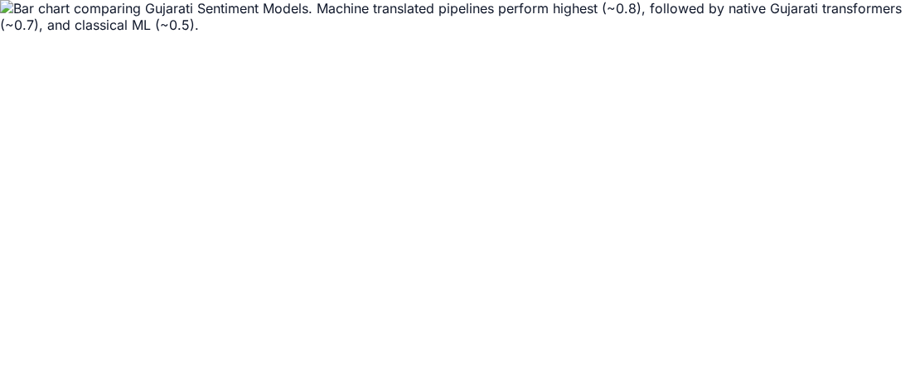
Model Performance Grouped by Dataset

Slide 23
CROSS-DOMAIN TRANSFER
0.8092
Trained on Product (Transl.) → Tested on Movie (Native)
Reaches ~96% of the in-domain ceiling without seeing a single movie review.

Slide 24
The Zero-Shot Boundary Condition
On Product (Short/Transl.): 0.8537 F1. Strong cross-lingual capability.
On Movie (Long/Native): Total collapse. Labels 452 of 453 as "Neutral".
Conclusion: Degenerates when pushed outside its short-text design range.

Slide 25
Pooling Strategies: Mean vs. CLS
THE VERDICT
Mean Pooling Wins 16/16
Mean pooling beat CLS pooling in every single encoder-task pair evaluated.
"For frozen representations, the CLS vector of a model trained only with masked language modeling has no reason to be a sentence summary."

Slide 26


The Fine-Tuning Inversion
Fine-Tuned Rank
Frozen Rank
Takeaway
IndicBERT v1 leads the published fine-tuned baselines.
IndicBERT v1 is the weakest frozen encoder on every task.
Fine-tuned leaderboards do not predict frozen representation quality.

Slide 27
The Translation Confound
Product vs. Movie: Differ in origin, language, polarity, and length simultaneously.
Interaction Test: Difference between gaps fails significance across all variants.
Hypothesis Only: Superiority on translated text remains a hypothesis, not a proven artifact.

Slide 28



Real-Time Web Application
Live Switching
Confidence Scores
LIME Explainability
Toggle between MuRIL, IndicBERT, Classical ML, and Translate pipelines instantly.
Per-class probability bars visualized for transparency.
Highlights exact Gujarati words driving the sentiment prediction.

Slide 29
Study Limitations
1
2
3
Small Native Corpus
Confounded Corpora
No Fine-Tuning
453 texts limits statistical power.
Only one corpus per condition.
Scores strictly limited to frozen regime.

Slide 30
Conclusion
A frozen Indic encoder (IndicBERT v2) delivers highly competitive performance natively on clean, synthetic text.
However, for noisy, natively written Gujarati text, frozen encoders offer no statistically significant advantage over simple character n-grams.
Better data, not just better models, remains the binding constraint for Gujarati sentiment analysis.

